Slide 1
Index number construction and new variable derivation
United Nations Statistics Division (UNSD)
17 March 2010 ECLAC, Santiago
Workshop on Manufacturing Statistics for ECLAC member states
Slide <number> of 89

Slide 2
Overview
Index numbers: basic theory
International recommendation for the Index of Industrial Production (IIP)
Key recommendations in constructing IIP
Other specific issues (only discuss if there is time)
  Reweight, linking and referencing the series
  Two main concepts in calculating the Index of Industrial Production (IIP)
Composite Index
17 March 2010 ECLAC, Santiago
Workshop on Manufacturing Statistics for ECLAC member states
Slide <number> of 89

Slide 3
Index number: why?
Why index number?
  Concern with aggregation problems, over goods and services, time and space.
    How exactly should the microeconomic information involving possibly millions of prices and quantities be aggregated into a smaller number of price and quantity variables?
  Allow comparison of prices and quantities for a common group of items
    between different space such as geographical region (spatial index)
    at two point of time (temporal index)
17 March 2010 ECLAC, Santiago
Workshop on Manufacturing Statistics for ECLAC member states
Slide <number> of 89

Slide 4
Notations used in this presentation
Notations for temporal index
  p_{t :} prices (of a vector of commodities) at time t
  q_{t :} real quantities purchase (of a vector of commodities) at time t
  Suppose 2 periods
    Base period: t=0
    Current period: t=1
  (Notice: We are not looking at spatial dimension in this presentation)
17 March 2010 ECLAC, Santiago
Workshop on Manufacturing Statistics for ECLAC member states
Slide <number> of 89

Slide 5
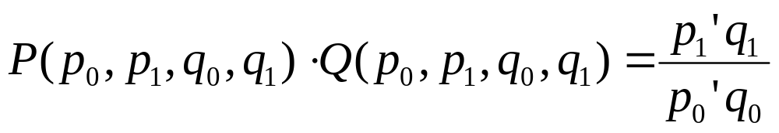
Index number problem
Index number problem:
  Find a price index P(p₀ ,p₁ , q₀ ,q₁), and
  a volume (quantity) index Q(p₀ ,p₁ , q₀ ,q₁) such that
i.e. To decompose a value ratio between 2 periods into 2 components
  overall change in prices between the two periods,
    i.e. price index P(p₀ ,p₁ , q₀ ,q₁)
  overall change in quantities between the two periods,
    i.e. volume (quantity) index Q(p₀ ,p₁ , q₀ ,q₁)
17 March 2010 ECLAC, Santiago
Workshop on Manufacturing Statistics for ECLAC member states
Slide <number> of 89

Slide 6
Examples of Price/Volume Indices in Official Statistics
Price indices
  Consumer Price Index (CPI), Producer Price Index (PPI), Spatial Price Index, etc.
Volume (Quantity) indices
  Index of Industrial Production (IIP), Index of Services, Retail Sales Index, etc.
Our focus is on volume indices
17 March 2010 ECLAC, Santiago
Workshop on Manufacturing Statistics for ECLAC member states
Slide <number> of 89

Slide 7


Examples:
Index of Industrial Production (Base year 2005=100) | Singapore | United States
2005 | 100 | 100
2006 | 110.3 | 102.4
Are the following statements correct?
  The industrial production of Singapore is larger in 2006 than in 2005.
  The industrial production of United States is larger in 2006 than in 2005.
  In 2006, the industrial production for Singapore is larger than United States.
17 March 2010 ECLAC, Santiago
Workshop on Manufacturing Statistics for ECLAC member states
Slide <number> of 89

Slide 8
Two types of comparison
Comparison of prices/quantities can occur between:
  different regions at a given time (spatial index)
    China compared to India, New York compared to Hong Kong
  two points in time at a given space (temporal index)
    2010 compared to 2009, Jan compared to Feb
Two separate but important concepts
  Difference in quantities across regions v.s. Change in quantities over time
  But, you cannot use temporal index to compare between countries at a given time, or use spatial index to compare change over time
    You cannot use IIP to compare industrial production across countries.
    You cannot use spatial price index to measure inflation.
17 March 2010 ECLAC, Santiago
Workshop on Manufacturing Statistics for ECLAC member states
Slide <number> of 89
Notes:
As already discussed there are two types of comparisons we normally look at (lots of others, compare prices between products, shops, customer, etc….):
Either compare prices between different regions – different countries or geographical areas
UK compared to France, Newport compared to Cardiff, Cardiff compared to London etc
More commonly can also compare prices between two points in time
Jan-Feb, Feb-March, 2008-2009, 2009 compared to ten years ago etc
These are two separate but important comparisons
Difference in price across regions v. Change in price over time

Slide 9
Summary so far
Index number problem
  Concern with aggregation problems, over goods and services, time and space.
  Allow comparison of prices and quantities for a common group of items
  Decompose value change into price change and volume (quantity) change
Two type of comparisons
  Temporal
    Difference in prices/quantities over time, at a given space
  Spatial
    Difference in prices/quantities across regions, at a given time.
Our focus is on volume (quantity) indices that compare quantity across time.
17 March 2010 ECLAC, Santiago
Workshop on Manufacturing Statistics for ECLAC member states
Slide <number> of 89

Slide 10
Volume indices - Overview
Measuring volume change of a fixed basket over time
Practical calculation of volume indices
  Laspeyres and Paasche indices
Volume indices for 3 or more periods
  Direct vs Indirect indices
17 March 2010 ECLAC, Santiago
Workshop on Manufacturing Statistics for ECLAC member states
Slide <number> of 89

Slide 11
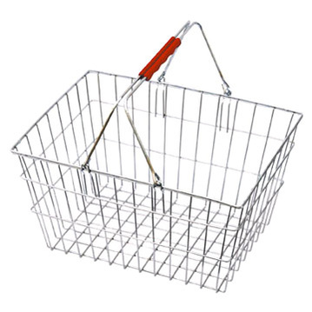

Fixed Basket Approach
the term Fixed means two things
  The type of goods and services remains the same from period to period
  The price of goods and services remains the same from period to period for volume index
The term Basket represents the actual goods and services included in the index, together with their price
17 March 2010 ECLAC, Santiago
Workshop on Manufacturing Statistics for ECLAC member states
Slide <number> of 89

Slide 12
Fixed Basket Volume Indices
Procedure to calculate the fixed basket volume indices
  Obtain the quantity for each product in the basket from the reference period
  Take the fixed price of each product in the basket
  Determine the value of the basket using
    fixed prices and
    quantities from the reference period
  For each successive period, determine the value of the basket using
    fixed prices
    quantities from that period
  At each period, the volume index is the ratio of the value of the basket to the value of the basket from the reference period (multiplied by 100)
17 March 2010 ECLAC, Santiago
Workshop on Manufacturing Statistics for ECLAC member states
Slide <number> of 89

Slide 13
Fixed price, bilateral volume indices
Comparison of volume from two periods
Fixed prices, HOW to choose?
  Earlier period?
    Using prices in the first period the index measures volume change from the perspective of the market situation prevailing in that period
    Laspreyres Index
  Later period?
    Conversely, choosing to fix the prices at the latest period will result in the index measuring volume change from the perspective of the latest period
    Passche Index
17 March 2010 ECLAC, Santiago
Workshop on Manufacturing Statistics for ECLAC member states
Slide <number> of 89

Slide 14
Index number approach
Right choice of how to fix price
  depends on what question we are trying to answer
  can fix the prices in any manner of ways
  need to consider economic and statistical theory
  need to consider practical issues
Index number approach
  Test/Axiomatic approach
    Treats the price and quantity data as independent
    Determine the most appropriate functional form for an index by specifying a number of axioms (tests) that the index ought to specify
  Economic approach (not the focus in this presentation)
    Treats the price and quantity data as dependent
    They are linked through a model of economic behaviour
17 March 2010 ECLAC, Santiago
Workshop on Manufacturing Statistics for ECLAC member states
Slide <number> of 89

Slide 15
Laspeyres and Paasche indices
The Laspeyres and Paasche volume indices actually answer two different questions
Using last year prices, what is the value of the basket this year?
Laspeyres
Using this year prices, what is the value of the basket last year?
Passche
17 March 2010 ECLAC, Santiago
Workshop on Manufacturing Statistics for ECLAC member states
Slide <number> of 89

Slide 16
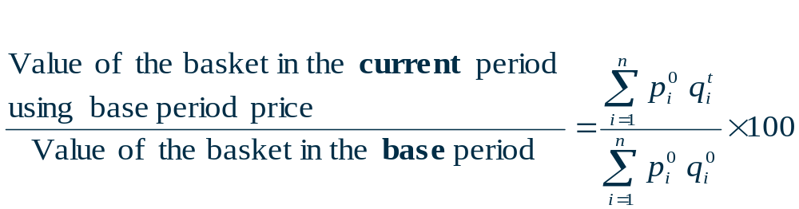
Laspeyres Volume Index
Fixes prices from the base period
How much more would the value of basket be in the current period if the price in the current period is the same the base period?"
17 March 2010 ECLAC, Santiago
Workshop on Manufacturing Statistics for ECLAC member states
Slide <number> of 89

Slide 17
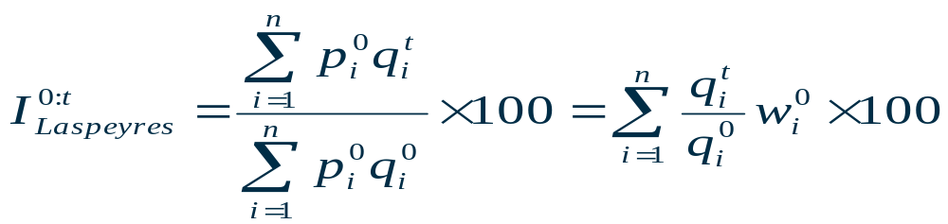
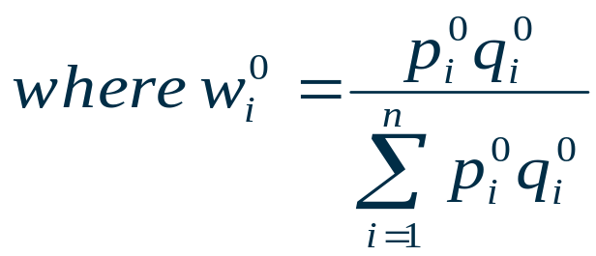
Laspeyres Volume Index – Another form
Volume index formulae may be rewritten so that indices may be constructed using values instead of prices
The value share (weight) at period 0 prices and quantities for item i
17 March 2010 ECLAC, Santiago
Workshop on Manufacturing Statistics for ECLAC member states
Slide <number> of 89

Slide 18
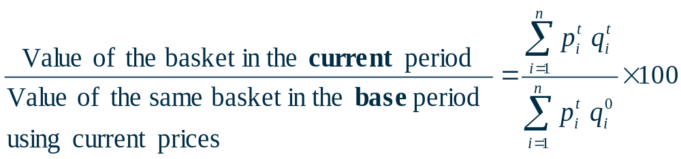
The Paasche volume index
Fixes prices from the current period
How much more would the value of basket be in the current period if the same basket in the base period is valued at current price?“
17 March 2010 ECLAC, Santiago
Workshop on Manufacturing Statistics for ECLAC member states
Slide <number> of 89

Slide 19
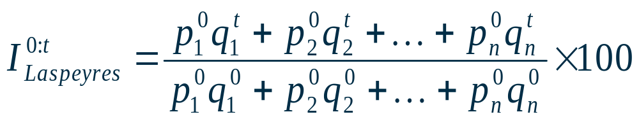
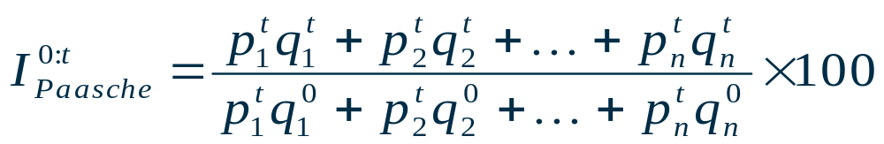
Comparison
Which index is better
  No information as to suggest which set of quantities yields a better result
  Some compromise seems reasonable
    Use prices that are some sort of average between the two periods
    Take some sort of average of the two indices
17 March 2010 ECLAC, Santiago
Workshop on Manufacturing Statistics for ECLAC member states
Slide <number> of 89

Slide 20
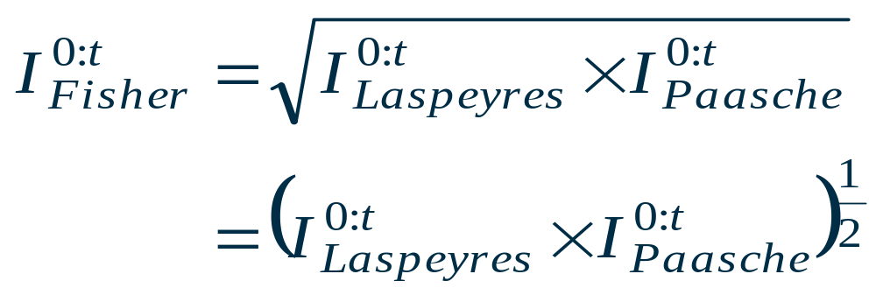
The Fisher Ideal volume index
A geometric mean of the Laspeyres and the Paasche
17 March 2010 ECLAC, Santiago
Workshop on Manufacturing Statistics for ECLAC member states
Slide <number> of 89

Slide 21
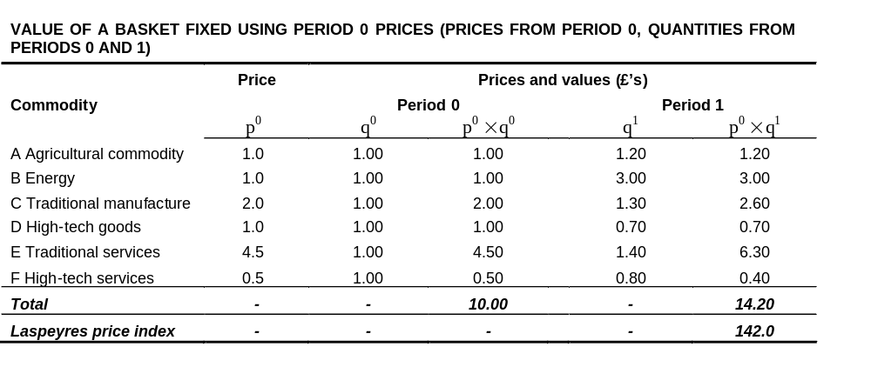
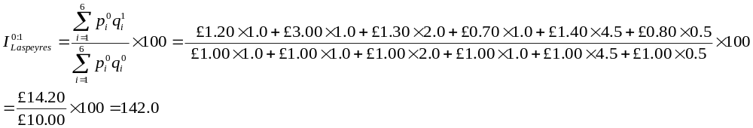
Example Laspeyres – revalue base period prices
17 March 2010 ECLAC, Santiago
Workshop on Manufacturing Statistics for ECLAC member states
Slide <number> of 89

Slide 22
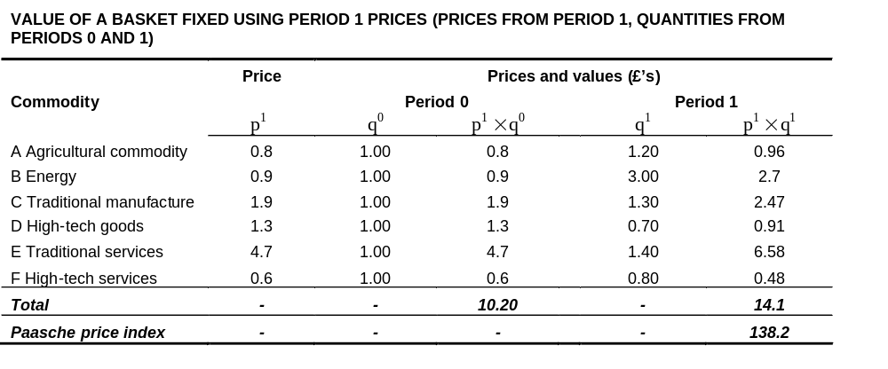
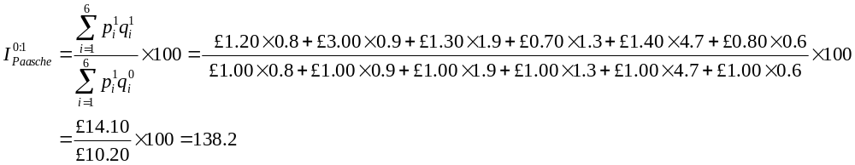
Example Paasche – revalue current period prices
17 March 2010 ECLAC, Santiago
Workshop on Manufacturing Statistics for ECLAC member states
Slide <number> of 89

Slide 23
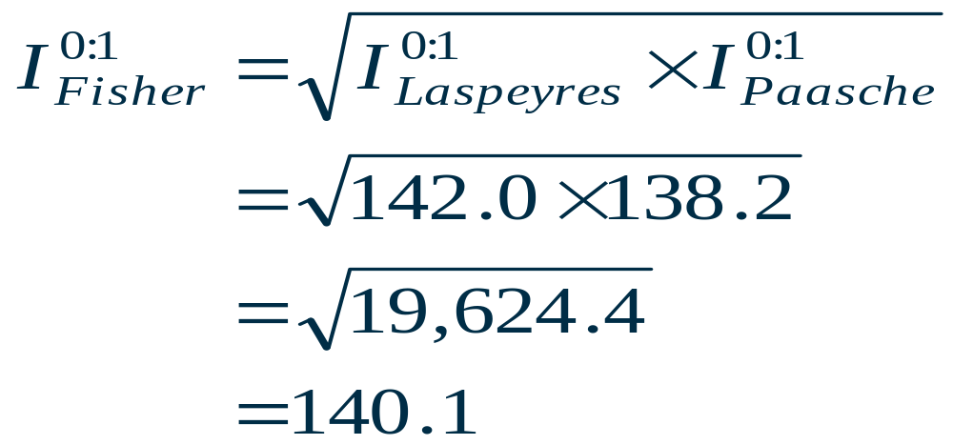
The Fisher Ideal Volume Index
17 March 2010 ECLAC, Santiago
Workshop on Manufacturing Statistics for ECLAC member states
Slide <number> of 89

Slide 24
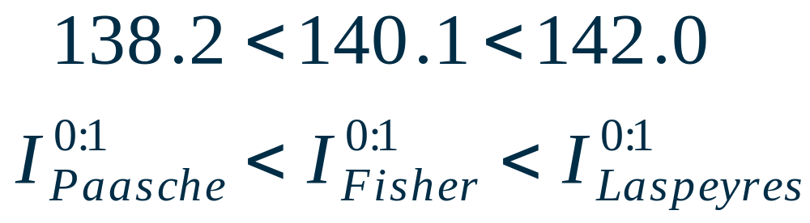
The Fisher Ideal Volume Index
17 March 2010 ECLAC, Santiago
Workshop on Manufacturing Statistics for ECLAC member states
Slide <number> of 89
Notes:
Prices Modular Training - Module 2
Choice of formula changes the result
Important result for consumer price indices: Laspeyres > Fisher > Paasche
This is to do with consumer behaviour. Some of the economic theory explaining this will be covered in more detail later today.

Slide 25
Fixed Base versus Chain Indices
To compare more than 3 periods
  Fixed base index (direct approach)
  Chain index (indirect approach)
17 March 2010 ECLAC, Santiago
Workshop on Manufacturing Statistics for ECLAC member states
Slide <number> of 89
Notes:
Prices Modular Training - Module 2
So far, focused on just 2 periods, not very useful. Users want a long time series

Slide 26
Fixed base volume index
Hold one period as the base period and compare all prices back to this period
Calculate movement back to the base period for each successive time point
Each index in the time series is a comparison from that period back to the base period
17 March 2010 ECLAC, Santiago
Workshop on Manufacturing Statistics for ECLAC member states
Slide <number> of 89

Slide 27
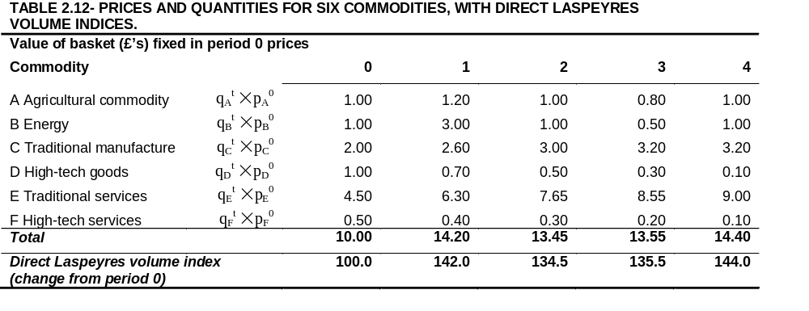
Fixed base indices
Direct (fixed base) volume indices, 0 to 4
17 March 2010 ECLAC, Santiago
Workshop on Manufacturing Statistics for ECLAC member states
Slide <number> of 89

Slide 28
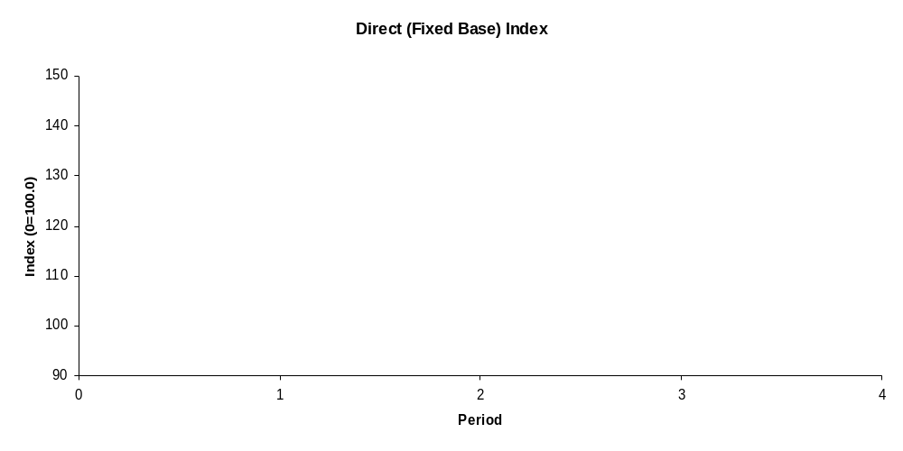
Fixed base indices
17 March 2010 ECLAC, Santiago
Workshop on Manufacturing Statistics for ECLAC member states
Slide <number> of 89
Notes:
Prices Modular Training - Module 2
Visually, fix quantities in the base period and re-price

Slide 29
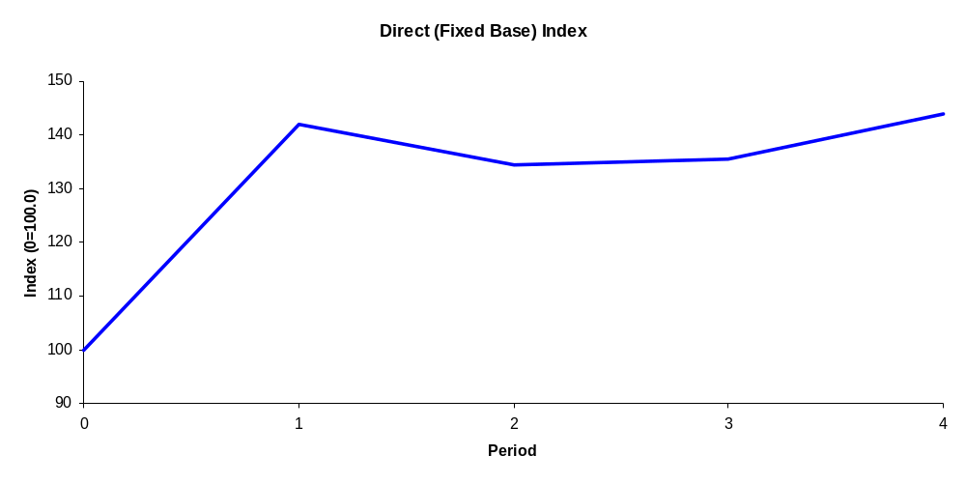
Fixed base indices
17 March 2010 ECLAC, Santiago
Workshop on Manufacturing Statistics for ECLAC member states
Slide <number> of 89
Notes:
Prices Modular Training - Module 2

Slide 30
Chain volume indices
Calculate consecutive period volume indices:
  Use a period 0 basket to look at period 0 to 1 changes
  Use a period 1 basket to look at period 1 to 2 changes
  Use a period 2 basket to look at period 2 to 3 changes
  Use a period 3 basket to look at period 3 to 4 changes
Chain these results together to get a measure of price change from 0 to 4
17 March 2010 ECLAC, Santiago
Workshop on Manufacturing Statistics for ECLAC member states
Slide <number> of 89

Slide 31
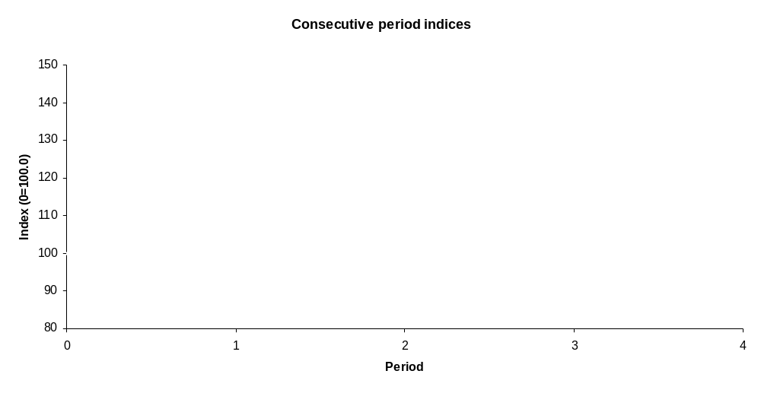
Chain indices
17 March 2010 ECLAC, Santiago
Workshop on Manufacturing Statistics for ECLAC member states
Slide <number> of 89
Module 2 - Constructing a Price Index
Notes:
Prices Modular Training - Module 2
Visually,
Use a period 0 basket to look at period 0 to 1 changes
Use a period 1 basket to look at period 1 to 2 changes
Use a period 2 basket to look at period 2 to 3 changes
Use a period 3 basket to look at period 3 to 4 changes

Slide 32
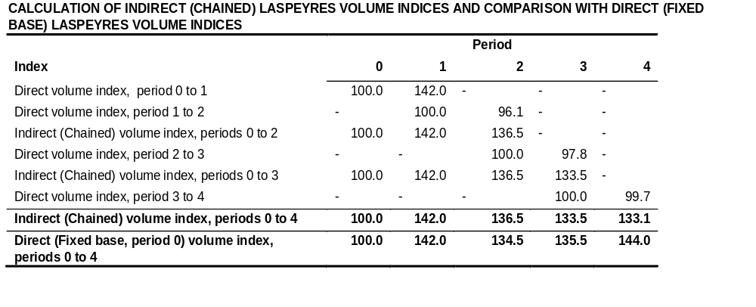
Chain indices
17 March 2010 ECLAC, Santiago
Workshop on Manufacturing Statistics for ECLAC member states
Slide <number> of 89
Notes:
Prices Modular Training - Module 2
Putting the results together,

Slide 33
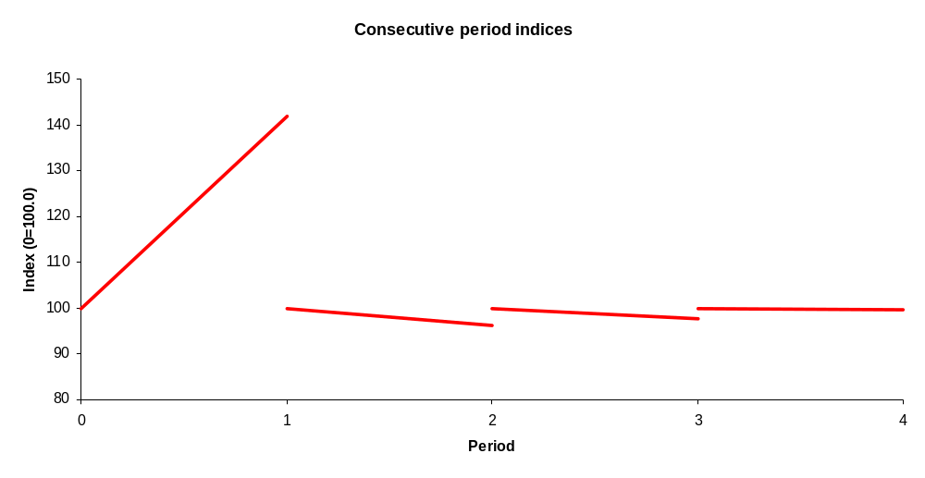
Chain indices
17 March 2010 ECLAC, Santiago
Workshop on Manufacturing Statistics for ECLAC member states
Slide <number> of 89
Module 2 - Constructing a Price Index
Notes:
Prices Modular Training - Module 2
Individual results, want to chain each of the movements into a single index

Slide 34
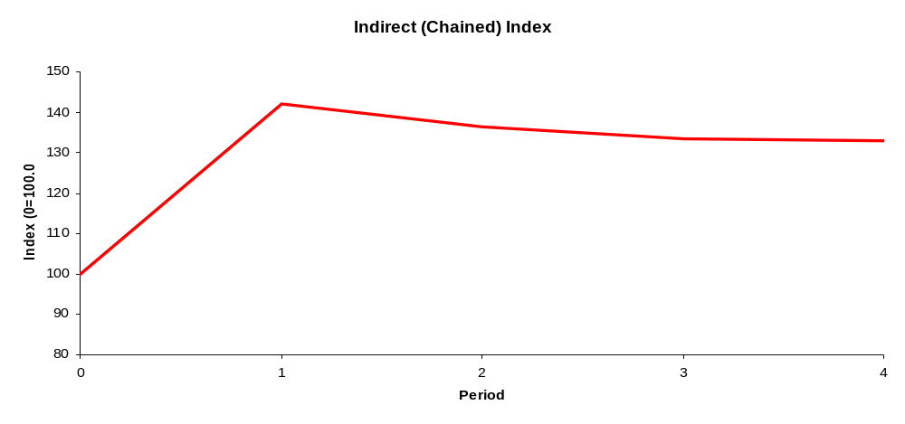
Indirect (chain) volume indices
Chaining!
17 March 2010 ECLAC, Santiago
Workshop on Manufacturing Statistics for ECLAC member states
Slide <number> of 89
Notes:
Prices Modular Training - Module 2

Slide 35
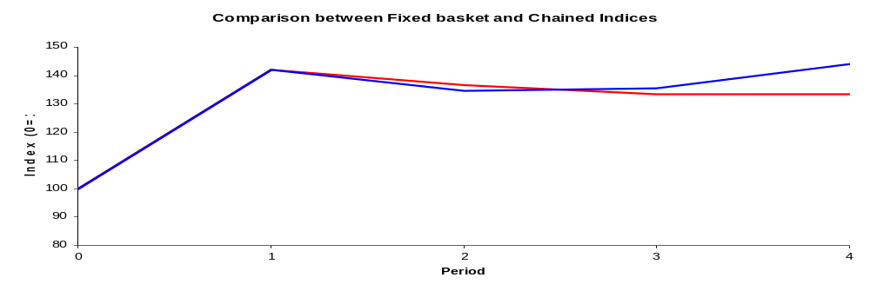
Comparison
Different result
  special case of equality is called a transitive index formula
    fixed baskets with differential weights never transitive
17 March 2010 ECLAC, Santiago
Workshop on Manufacturing Statistics for ECLAC member states
Slide <number> of 89
Notes:
Prices Modular Training - Module 2
Comparing the direct with indirect, indirect is lower, can see in period 3 to 4 they actually move in different directions

Slide 36
Fixed Base versus Chain Indices
Fixed base result more attractive operationally
  one revaluing step
  one set of price data
Why would we chain?
  Updating the basket and weights!
Recommendation for IIP
  Annual chainlinking (will be discussed later)
17 March 2010 ECLAC, Santiago
Workshop on Manufacturing Statistics for ECLAC member states
Slide <number> of 89

Slide 37
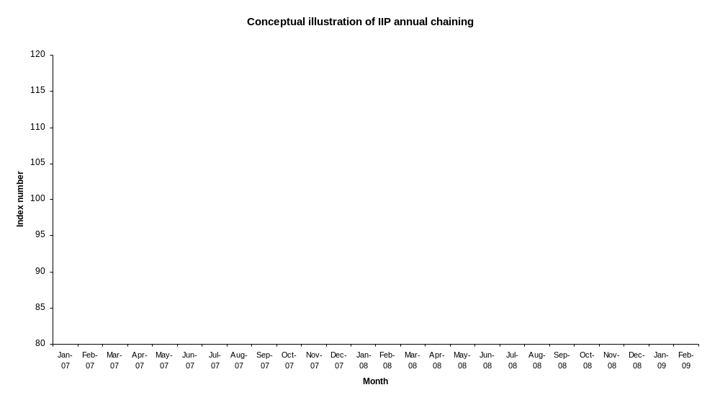
17 March 2010 ECLAC, Santiago
Workshop on Manufacturing Statistics for ECLAC member states
Slide <number> of 89
Notes:
Prices Modular Training - Module 2
Click through
Direct index through the year
Indirect between years
Question, what does this mean for our 12 month % change, which basket are we using??
Ans: combination of old up to Jan and new from Jan

Slide 38
Summary
Volume indices can be constructed by deflating a fixed basket of commodities with fix prices
When constructing a volume index, choice of fixed prices from different periods gives different volume index number formulae
  Laspeyres
  Passche
  Fisher
For comparison over three periods or more, two approaches were introduced
  Fixed base approach
  Chain approach
17 March 2010 ECLAC, Santiago
Workshop on Manufacturing Statistics for ECLAC member states
Slide <number> of 89

Slide 39
Index of Industrial Production (IIP)
IIP is a volume index.
Purpose:
  Reflect the volume developments in goods or services produced over time
  Provide a measure of the short-term changes in value added over a given reference period.
Use
  Important short-term indicators to assess the performance of an economy
  In some countries, a key input for calculating volume measures as part of the compilation of the quarterly national account
17 March 2010 ECLAC, Santiago
Workshop on Manufacturing Statistics for ECLAC member states
Slide <number> of 89

Slide 40
Major issues
Major issues to consider
  Statistical unit, classifications and the business register
  Scope and frequency
  Sources and methods
  Index compilation
  Presentation and dissemination
International Recommendation of Index of Industrial Production (IRIIP)!
17 March 2010 ECLAC, Santiago
Workshop on Manufacturing Statistics for ECLAC member states
Slide <number> of 89

Slide 41
International Recommendations for the Index of Industrial Production (IRIIP)
Index of Industrial Production has been calculated since the 1920s
  UNSD has collected series going back to 1938
  Methodology was described in 1950 UN Manual on “Index of industrial production”
    Number 1 in series of publications on international recommendations and guidelines (Series F)
The manual was under revision since 2005, and the updated IRIIP was adopted by the United Nations Statistical Commission in 2010
17 March 2010 ECLAC, Santiago
Workshop on Manufacturing Statistics for ECLAC member states
Slide <number> of 89

Slide 42
Objectives of revised IRIIP
Outline practical and suitable measurement methods and document issues and benefits from recent theoretical and practical work in the area.
Assist countries/data compilers
  in producing more accurate IIP.
  in producing index numbers in comparable ways
  that plan to set up a more comprehensive systems of volume measures
    by providing the methodological foundations for the IIP
    by giving practical guidance on individual steps and elements of the compilation process
It is recognized that due to practical constraints, some of the recommendations in this publication may not be immediately attainable by all statistical offices and, therefore, should serve as guideposts for agencies as they revise and improve their IIP programs
17 March 2010 ECLAC, Santiago
Workshop on Manufacturing Statistics for ECLAC member states
Slide <number> of 89

Slide 43
Additional inputs considered
Recent work on other index number publications:
  Producer Price Index Manual (World Bank et al., 2004)
  Consumer Price Index Manual (ILO et al., 2004)
  Handbook on price and volume measures in national accounts (Eurostat, 2001)
  Compilation Manual for an Index of Service Production (OECD, 2007)
New manual should be consistent with other existing manuals (e.g. IRIS & SNA)
17 March 2010 ECLAC, Santiago
Workshop on Manufacturing Statistics for ECLAC member states
Slide <number> of 89

Slide 44
Publication structure
Part I includes a description of the international recommendations, covering scope, fundamental concepts, etc.
  It is encouraged that countries comply with the recommendations set out in Part I.
Part II includes international guidance to assist countries in implementing these recommendations
  It presents a set of methods (categorized as ‘preferred’, ‘alternative’ and ‘other’) and variables for each ISIC Rev. 4 class in scope of this publication for the compilation of an IIP, based on current country practices
17 March 2010 ECLAC, Santiago
Workshop on Manufacturing Statistics for ECLAC member states
Slide <number> of 89

Slide 45
Major changes
Scope
  Enlarged definition of “industry”
Recommended calculation method
  Deflation vs volume extrapolation
    Deflation : Use a price deflator to remove the price component from an overall value measure, isolating the volume component
    Volume extrapolation: Build a measurement that uses only volume changes at detailed level
Frequency of weight updates
  Annual updates vs. 5-yearly updates
  Chain linking vs. fixed-weight approach
Other recommendations, such as on seasonal adjustment or dissemination issues reflect an update of previous recommendations as well
17 March 2010 ECLAC, Santiago
Workshop on Manufacturing Statistics for ECLAC member states
Slide <number> of 89

Slide 46
Key issues/recommendations
1: Statistical units, classifications & business register
  Statistical unit: establishment
  Classification
    International Standard Industrial Classification of All Economic Activities (ISIC) Rev.4 for industry classification
    Central Product Classification (CPC) Rev. 2 for product classification.
  Business register and data source
    Business register as a basis from which a sampling frame is identified
    Sample selection is updated each year to coincide with the updates of weights.
    Utilize administrative source for the purpose of developing and maintaining a sampling frame and as a data source to reduce response burden
17 March 2010 ECLAC, Santiago
Workshop on Manufacturing Statistics for ECLAC member states
Slide <number> of 89

Slide 47
Key issues/recommendations
2: Frequency
  Publication recommends monthly compilation of the IIP so that turning points in economic activity can be identified as early as possible
17 March 2010 ECLAC, Santiago
Workshop on Manufacturing Statistics for ECLAC member states
Slide <number> of 89

Slide 48
Key issues/recommendations
3: Scope of the IIP:
  Scope is defined to cover activities in sections B - E of ISIC Rev.4
    Mining and quarrying (B)
    Manufacturing (C )
    Electricity, gas steam and air-conditioning supply (D)
    Water supply, sewerage, waste management and remediation activities (E)
  Section E contains new areas for inclusion in the IIP
  This scope coincides with the scope of the International Recommendations for Industrial Statistics (IRIS) 2008, which includes the index numbers of industrial production in its list of recommended indicators
17 March 2010 ECLAC, Santiago
Workshop on Manufacturing Statistics for ECLAC member states
Slide <number> of 89

Slide 49
Key issues/recommendations
4: Index formula
  Laspeyres-type index is recommended
    Preferred due to feasibility over Paasche or Fischer index
  Chain linked, rather than fixed base indices are recommended
5: Weights and updates
  Weights for industry branches
  Product group weights
  Product weights
17 March 2010 ECLAC, Santiago
Workshop on Manufacturing Statistics for ECLAC member states
Slide <number> of 89

Slide 50
IIP weights
Stage 3: Weights for industry branches – Gross value added at basic prices
Total IIP
1-digit ISIC
2-digit ISIC
3-digit ISIC
4-digit ISIC
Stage 2: Product group weights – Value of output obtained via census/survey
Product groups assigned to one 4 digit ISIC branch
Stage 1: Product weights –
Value of output obtained via census/survey
Individual sampled products assigned to one product group
17 March 2010 ECLAC, Santiago
Workshop on Manufacturing Statistics for ECLAC member states
Slide <number> of 89

Slide 51
5. Weights and updates (cont.)
  Industry level weights
    Annual update should be carried out.
    Should ideally be National Accounts value added figures at basic prices – adjustments necessary to make them timely available.
  Product group weights
    Should be updated frequently at least every 5 years
    Obtained by determining the share of value of output, via the conduct of product census or surveys
  Product weights
    The weights of individual products are updated at the same time as product group
    Obtained by determining the share of value of output, via the conduct of product census or surveys
17 March 2010 ECLAC, Santiago
Workshop on Manufacturing Statistics for ECLAC member states
Slide <number> of 89

Slide 52
Key issues/recommendations
6: Calculation method
  Deflation should be used to obtain volume estimates from value data, rather than volume extrapolation method
    PPI is recommended as deflator
    Deflation should be done at lowest level, i.e. 4-digit industry level
  Exceptions are made by industry, e.g. if only a small set of products exist and if quality changes are not a major concern
    Volume aggregation still works for these exceptional area
    Chapter 7 of the publication provides recommendations by industry, including choice of variables
17 March 2010 ECLAC, Santiago
Workshop on Manufacturing Statistics for ECLAC member states
Slide <number> of 89

Slide 53
Key issues/recommendations
7. Variables to be used
  To approximate industrial production for the IIP, output measures (value or physical quantity of output) are preferred over input measures (labour or materials consumed)
  The publication provides suggestions for preferred, alternate and other methods for the use of variables in the IIP calculation.
    Suggestions are specific for each ISIC industry at 4-digit level
17 March 2010 ECLAC, Santiago
Workshop on Manufacturing Statistics for ECLAC member states
Slide <number> of 89

Slide 54
Key issues/recommendations
8: Data adjustments
  Adjustments should be made for quality changes
    Either through the correction of PPI used in deflation, or
    by adjusting input data when volume aggregation is used
  Data series should be produced as working day adjusted as well as seasonally adjusted series
17 March 2010 ECLAC, Santiago
Workshop on Manufacturing Statistics for ECLAC member states
Slide <number> of 89

Slide 55
Example of recommendations
ISIC Description | Explanatory notes | Product or product groups, by industry | Preferred method | Alternate method | Other methods
1104 Manufacture of soft drinks; production of mineral waters and other bottled waters | This class includes: - manufacture of non-alcoholic beverages, except non-alcoholic beer and wine | Waters (including mineral waters and aerated waters), not sweetened nor flavoured, except natural water, ice and snow Other non-alcoholic beverages | Deflated indicator Value of output deflated by appropriate quality adjusted PPI | Volume indicator Quantity (count) of products produced, by product | Volume indicator Number of hours worked adjusted for changes in productivity
17 March 2010 ECLAC, Santiago
Workshop on Manufacturing Statistics for ECLAC member states
Slide <number> of 89

Slide 56
Example of recommendations
ISIC Description | Explanatory notes | Product or product groups, by industry | Preferred method | Alternate method | Other methods
2750 Manufacture of domestic appliances | This class includes the manufacture of small electric appliances and electric housewares. | Refrigerators Freezers Dishwashers Washing and drying machines Vacuum cleaners Electric water heaters | Deflated indicator Value of output deflated by appropriate quality adjusted PPI | Volume indicator Quantity (count) of products produced, by product | Volume indicator Number of hours worked adjusted for changes in productivity
17 March 2010 ECLAC, Santiago
Workshop on Manufacturing Statistics for ECLAC member states
Slide <number> of 89

Slide 57
Key issues/recommendations
9: Dissemination
  The publication outlines elements / requirements for the dissemination of IIP data
  General requirements for international reporting are set in the International Recommendations for Industrial Statistics (IRIS) 2008
  UNSD data collection will continue at 2-digit ISIC level for annual and quarterly data, 1-digit ISIC level for monthly data
    Currently for raw (unadjusted) data only
    Will switch to ISIC Rev.4 for production of regional IIP
17 March 2010 ECLAC, Santiago
Workshop on Manufacturing Statistics for ECLAC member states
Slide <number> of 89

Slide 58
Outsourcing
Products can include the manufacturing services of CPC Ver.2 Division 88 & 89
  88 – Manufacturing services on physical inputs owned by others
  89 – Other manufacturing services; publishing, printing and reproduction services;
If unit A outsource part of its production to another unit B that now provides manufacturing services to A
  Unit A: Intermediate inputs that are outsourced to B should be counted as intermediate consumption and be deducted from the unit’s gross output.
  Unit B: Gross output increases
17 March 2010 ECLAC, Santiago
Workshop on Manufacturing Statistics for ECLAC member states
Slide <number> of 89

Slide 59
Summary
We have described the purpose and the use of IIP
In constructing the IIP, several issues needed to be considered. The International Recommendation for the Index of Industrial Production (IRIIP), which was recently updated and adopted by UNSC 2010, providing several key recommendations in IIP construction.
Major changes
  Enlarged scope of IIP
  Deflation over volume extrapolation method
  Annual updates over. 5-yearly updates
  Chain linking over fixed-weight approach
17 March 2010 ECLAC, Santiago
Workshop on Manufacturing Statistics for ECLAC member states
Slide <number> of 89

Slide 60
Re-weighting, linking and re-referencing the IIP
17 March 2010 ECLAC, Santiago
Workshop on Manufacturing Statistics for ECLAC member states
Slide <number> of 89

Slide 61
IIP weights
Stage 3: Weights for industry branches – Gross value added at basic prices
Total IIP
1-digit ISIC
2-digit ISIC
3-digit ISIC
4-digit ISIC
Stage 2: Product group weights – Value of output obtained via census/survey
Product groups assigned to one 4 digit ISIC branch
Stage 1: Product weights –
Value of output obtained via census/survey
Individual sampled products assigned to one product group
17 March 2010 ECLAC, Santiago
Workshop on Manufacturing Statistics for ECLAC member states
Slide <number> of 89

Slide 62
More about weights
Over time, relative importance may change
  Products within a product group
  Product groups within an industry
  Lower level industries within higher level aggregates
For the IIP to reflect the movements as good as possible, the weights have to reflect these changes
17 March 2010 ECLAC, Santiago
Workshop on Manufacturing Statistics for ECLAC member states
Slide <number> of 89

Slide 63
Weights
Weights are used to aggregate series into higher level aggregates
  Can be done at different levels
  Weights have to be chosen accordingly
Weights have to reflect the relative importance of the individual components within the aggregate
17 March 2010 ECLAC, Santiago
Workshop on Manufacturing Statistics for ECLAC member states
Slide <number> of 89

Slide 64
Old recommendations
Use fixed weights for the calculation
Update weights every 5 years
Recalculate entire series
Problem:
  New weights may reflect better the movements in the current periods, but they are not applicable for past data (far from new weight period)
    Problem simply shifts to a different period
17 March 2010 ECLAC, Santiago
Workshop on Manufacturing Statistics for ECLAC member states
Slide <number> of 89

Slide 65
New recommendations
Update weights more frequently
  Recommended: Annually
Do not re-calculate entire series
Use chain linking to produce time series for IIP
17 March 2010 ECLAC, Santiago
Workshop on Manufacturing Statistics for ECLAC member states
Slide <number> of 89

Slide 66
New recommendations
Chain-linking annually rebased series allows for better reflection of current economic structure in the weights in each of the sub-series
  Current period and weight base period are not too far apart
17 March 2010 ECLAC, Santiago
Workshop on Manufacturing Statistics for ECLAC member states
Slide <number> of 89

Slide 67
Linking
How to link the individual sub-series to obtain longer time series?
A linking factor has to be determined to link the new series to the existing historical series
  This factor is then applied to the new (old) series to convert it to the old (new) base year
17 March 2010 ECLAC, Santiago
Workshop on Manufacturing Statistics for ECLAC member states
Slide <number> of 89

Slide 68

Linking
The long-term time series are calculated from a succession of short-term series with updated weights
    Note: Short-term series can span any number of periods
17 March 2010 ECLAC, Santiago
Workshop on Manufacturing Statistics for ECLAC member states
Slide <number> of 89

Slide 69
Linking options
Annual overlap, linking factor based on
  annual index for years t
  index of the same year using weights of year t-1
One-quarter overlap, linking factor based on
  index of the first quarter of year t
  Index of the same quarter using weights of year t-1
Over-the-year technique
  Linking factor based on same periods for years t and t-1
17 March 2010 ECLAC, Santiago
Workshop on Manufacturing Statistics for ECLAC member states
Slide <number> of 89

Slide 70
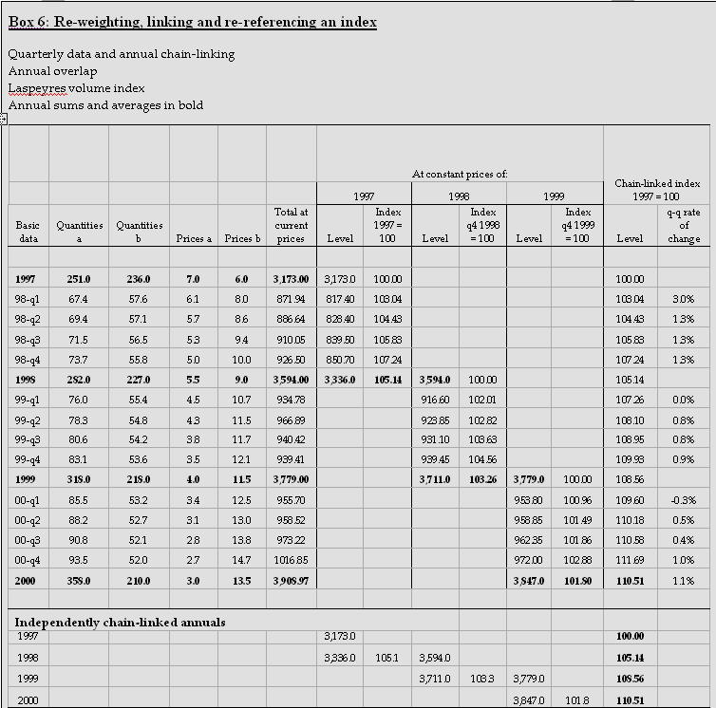
17 March 2010 ECLAC, Santiago
Workshop on Manufacturing Statistics for ECLAC member states
Slide <number> of 89

Slide 71
Recommended method ?
Annual overlap technique
  More practical for Laspeyres-type volume measures
  Monthly/quarterly data aggregate to annual data
    However, there are no clear established rules for choosing this approach
    In most cases, the approaches will give similar results
17 March 2010 ECLAC, Santiago
Workshop on Manufacturing Statistics for ECLAC member states
Slide <number> of 89

Slide 72
Two main approaches to calculate the IIP
17 March 2010 ECLAC, Santiago
Workshop on Manufacturing Statistics for ECLAC member states
Slide <number> of 89

Slide 73
Goal
Measure volume changes over time
  The measurement should not reflect price changes in the measurement period
17 March 2010 ECLAC, Santiago
Workshop on Manufacturing Statistics for ECLAC member states
Slide <number> of 89

Slide 74
Options
1) Build a measurement that uses only volume changes at detailed level
  “Volume extrapolation”
2) Use a price deflator to remove the price component from an overall value measure, isolating the volume component
  “Deflation”
17 March 2010 ECLAC, Santiago
Workshop on Manufacturing Statistics for ECLAC member states
Slide <number> of 89

Slide 75
Recommended approach
The 1950 IIP manual relied on the volume extrapolation approach
The 2010 IIP manual recommends mostly the deflation method
  Recommendations depend on industry (see chapter 7)
17 March 2010 ECLAC, Santiago
Workshop on Manufacturing Statistics for ECLAC member states
Slide <number> of 89

Slide 76
What separates the two approaches?
Calculation method (formula)
Data requirements
  Data availability
Work load
Stability, ability to adapt
17 March 2010 ECLAC, Santiago
Workshop on Manufacturing Statistics for ECLAC member states
Slide <number> of 89

Slide 77
Volume extrapolation
concept : utilize the movements in volumes directly to calculate an IIP
suitable : volume variables
formula : IIP=Q₁/Q₀ (at elementary/product level)
  Use weights to aggregate to higher levels
17 March 2010 ECLAC, Santiago
Workshop on Manufacturing Statistics for ECLAC member states
Slide <number> of 89

Slide 78
Volume extrapolation
Possible input data:
  Output variables
    Physical quantity of output (at individual product
  Input variables
    Labor input
    Materials consumed
While input data are sometimes easier to obtain, they assume a fixed relationship between input and output
17 March 2010 ECLAC, Santiago
Workshop on Manufacturing Statistics for ECLAC member states
Slide <number> of 89

Slide 79
Volume extrapolation
Data requirements
  Data need to be available for a detailed set of products
    Volume extrapolation starts at the product level, then aggregates through product groups and industries
  Products have to be representative for the respective industries fro which the IIP is compiled
Work load
  High due to need for detailed product data (collection and processing)
17 March 2010 ECLAC, Santiago
Workshop on Manufacturing Statistics for ECLAC member states
Slide <number> of 89

Slide 80
Volume extrapolation
Stability
  In some areas, shifting of production between products (or product groups) can negatively influence the data quality
    Example: pharmaceuticals
Ability to adapt
  Difficult to account for quality changes
17 March 2010 ECLAC, Santiago
Workshop on Manufacturing Statistics for ECLAC member states
Slide <number> of 89

Slide 81
Deflation method
concept : isolate the volume component from value variables
suitable : value variables
formula :
IIP=(Value₁/Price index) / Value₀
  =(∑P₁Q₁/Price Index) / ∑P₀Q₀
    At level where price index is available
17 March 2010 ECLAC, Santiago
Workshop on Manufacturing Statistics for ECLAC member states
Slide <number> of 89

Slide 82
Deflation method
Possible input data:
  Output variables:
    Value of output
    Value of output sold
  Needed only at more aggregated level than data for volume extrapolation
17 March 2010 ECLAC, Santiago
Workshop on Manufacturing Statistics for ECLAC member states
Slide <number> of 89

Slide 83
Deflation method
Data requirements
  Data need to be available only at a higher level of aggregation
  BUT: “Appropriate” deflator (price index) needs to be available at this level too
  Deflation should take place at lowest level possible
    Typically: 4-digit ISIC level; could be product group level
17 March 2010 ECLAC, Santiago
Workshop on Manufacturing Statistics for ECLAC member states
Slide <number> of 89

Slide 84
Deflation method
Work load
  Reduced (less detailed data collection and processing)
  BUT: price index needs to be calculated
    Responsibility shifts to another area
    “Duplication” of work can be avoided
17 March 2010 ECLAC, Santiago
Workshop on Manufacturing Statistics for ECLAC member states
Slide <number> of 89

Slide 85
Deflation method
Stability
  Price movements are more stable than quantity movements in many areas
  Deflation provides a better tool (while investing same amount of work) to calculate IIP for areas with frequently/seasonally shifting product patterns
Ability to adapt
  Quality effects are accounted for in the deflator (price index)
17 March 2010 ECLAC, Santiago
Workshop on Manufacturing Statistics for ECLAC member states
Slide <number> of 89

Slide 86
Composite Index
17 March 2010 ECLAC, Santiago
Workshop on Manufacturing Statistics for ECLAC member states
Slide <number> of 89

Slide 87
Composite Index
Formed when individual indicators are compiled into a single index, on the basis of an underlying model of the multi-dimensional concept that is being measured.
Measures multi-dimensional concepts (e.g. business cycle, competitiveness) which cannot be captured by a single indicator.
Ideally, a composite index should be based on a theoretical framework / definition, which allows individual indicators / variables to be selected, combined and weighted in a manner which reflects the dimensions or structure of the phenomena being measured.
17 March 2010 ECLAC, Santiago
Workshop on Manufacturing Statistics for ECLAC member states
Slide <number> of 89

Slide 88
Composite Index
Composite indices that assess the performance of an economy
  E.g. Cyclical composite Index, Turning point index
  Many high-frequency industrial statistics are used as components for these types of composite index
    such as IIP, output, production, capacity utilization, sales & orders, wages
17 March 2010 ECLAC, Santiago
Workshop on Manufacturing Statistics for ECLAC member states
Slide <number> of 89

Slide 89
Pros | Cons
Summarize complex, multi-dimensional realities with a view to supporting decision making | May send misleading policy messages if poorly constructed or misinterpreted
Are easier to interpret than a battery of many separate indicators | May invite simplistic policy conclusions
Reduce the visible size of a set of indicators without dropping the underlying information. Make it possible to include more information within the existing size limit | May be misused if the construction process is not transparent and/or lacks sound statistical or conceptual principles
Help to construct/underpin narratives for lay and literate audience | The selection of component variables and weights could be subject to political dispute
Enable users to compare complex dimensions effectively | May disguise serious failings in some dimensions and increase the difficulty of identifying proper remedial action, if the construction process is not transparent
17 March 2010 ECLAC, Santiago
Workshop on Manufacturing Statistics for ECLAC member states
Slide <number> of 89

